Slide 1
Topic 12 – Neural Nets, Deep Learning, and GenAI
Data Science and AI for Business – Fall 2025

Slide 2
Deep Learning - Intro
We learned the basics of neural nets in an earlier chapter
Biological inspirations
Black box models for regression and classification
NN explosion since the early 2000s
Moore’s law (computation and storage getting cheaper)
Funded research (Google Brain, MSFT, Facebook FAIR)
It is an incredibly complex and deeply technical field with a lot still to be figured out
Neural nets => Deep Learning => (Gen)AI => AGI(?!??)
ISL – Chap 10

Slide 3
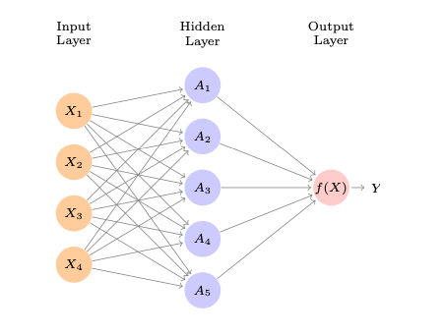
Recap: Single Layer Neural Network
Input Layer: features
Input layer is typically fully connected to a hidden layer using weights that define a linear combination
Nodes in hidden layer apply an activation function
Output layer gets transformed (perhaps via threshold) to a prediction
Weights are fit using training data – through iterative back-propogation

Slide 4
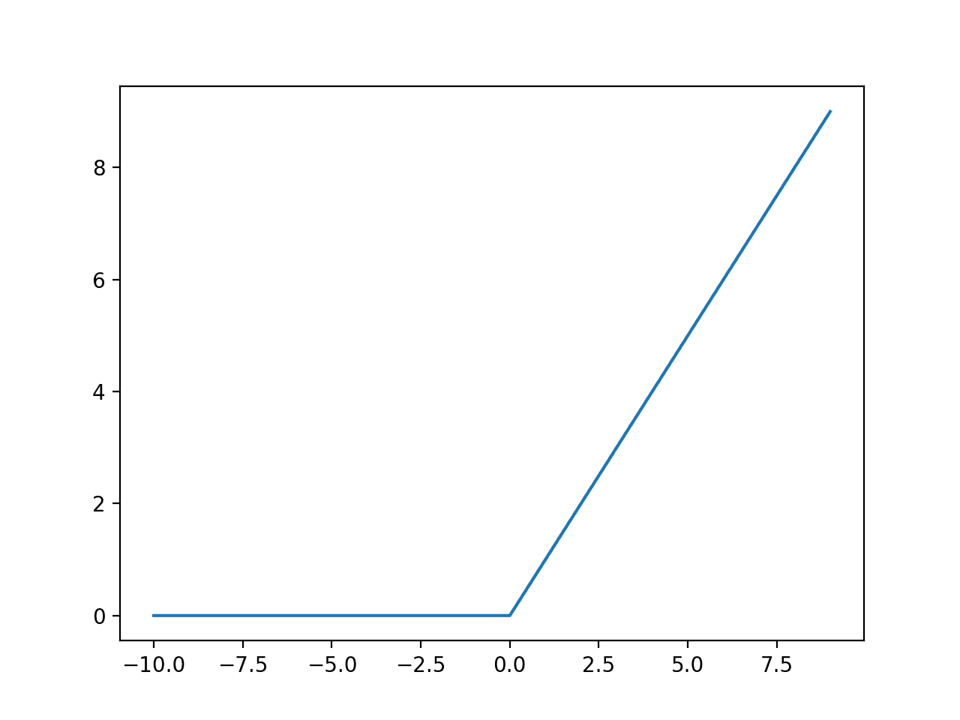
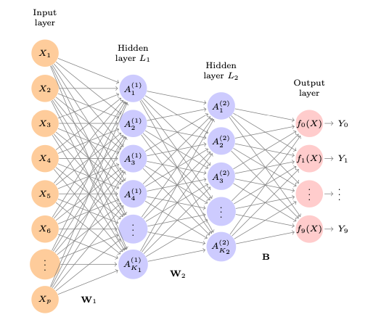
Neural Nets – Deep Learning
Neural nets with multiple hidden layers are referred to as deep.
Often the output layer has multiple classes (like images)
So many parameters!
only feasible within the last 15 years or so
Empirically, massive networks with very simple activation functions (ReLU) work best
ReLU
This is a deep learner used to predict handwritten digits
ISL p404
p = 28 x 28 = 784
Hidden layers have 256 and 128 nodes
Total of 235,146 parameters to fit
😱

Slide 5
Extensions of Neural Nets

Slide 6
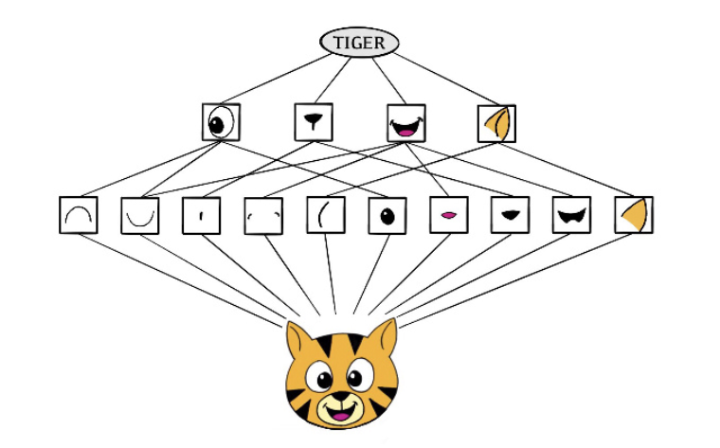
Convolutional Neural Nets (CNN)
Neural Net specifically built for media, images, etc
specifically for grid-based data (like image pixels)
Special layers called convolutional layers focus on detecting patterns such as edges, shapes and textures
Preserves spatial relationships (rather than just looking at each pixel separately
Motivated by how humans detect things
Higher level features: eyes, ears, shapes
Low level features: color, edges, textures

Slide 7
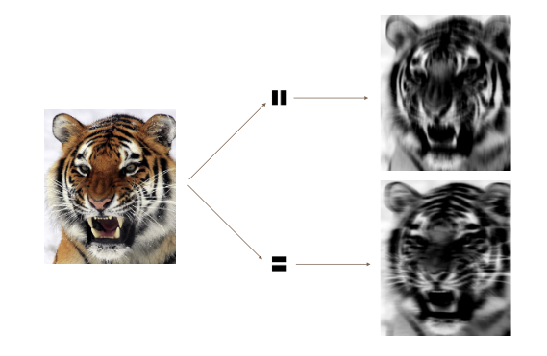
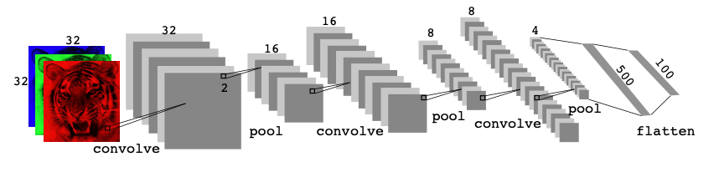
Convolutional Neural Nets (CNN)
Convolving allows you to look for specific patterns:
CNN architectures can be complicated!
Notes:
Like shining a flashlight

Slide 8
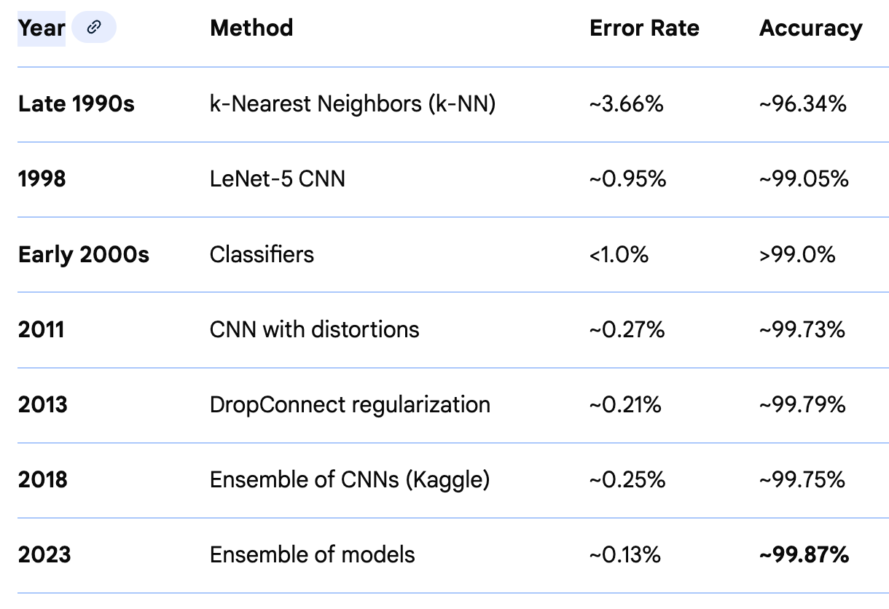
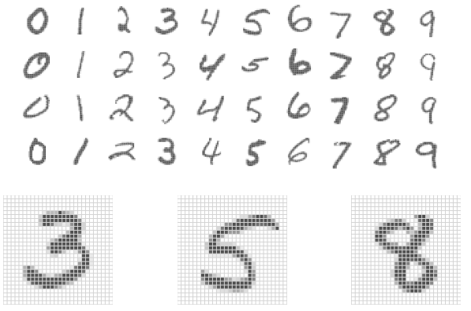
CNN wins! MNIST data
Handwritten digits
28 x 28 matrix of pixels
Each pixel has a value in (0,255)
60k training images
10k test images
Data freely available
How to get 99.8% performance!
Kaggle link
Notes:
Dropout reg: at different steps set random neurons to zero during different training iterations and averagine…

Slide 9
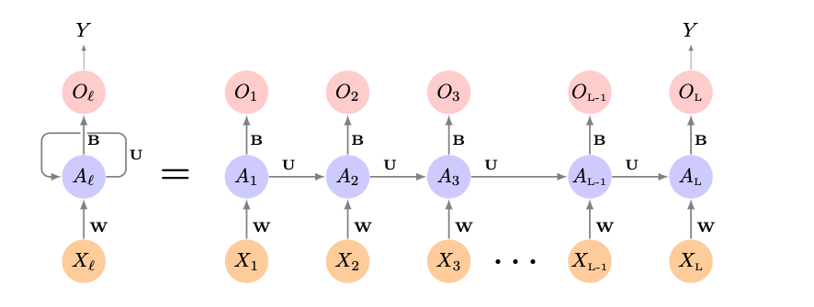
Recurrent Neural Networks (RNN)
Specifically built to handle data where order and context matter
Think words, speech, text
Time Series
RNNs take ordering into account
Keep information from previous inputs and use it to process following inputs
Architecture is sequential and has memory
Keeps a “running mental summary” as it moves along…
But….struggle with long term dependencies
Notes:
LSTMS are able to keep “context” from earlier in the document while parsing local context from most recent context.

Slide 10
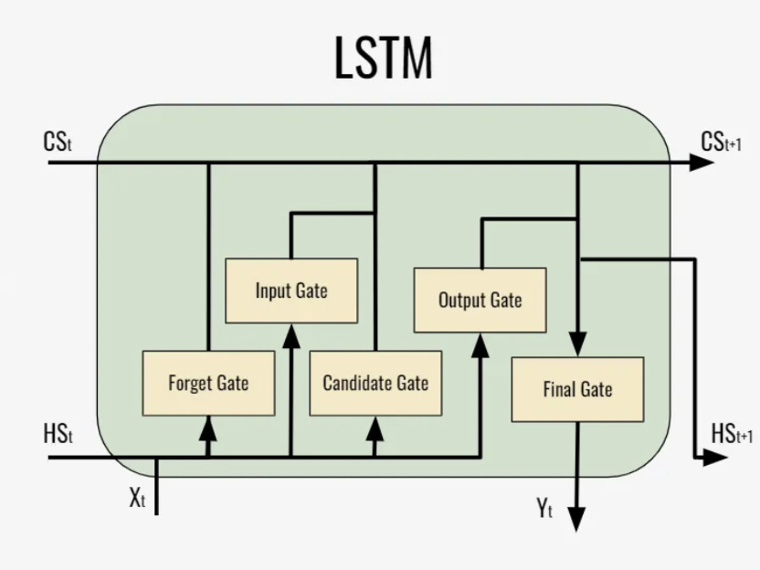
Long Short-Term Memory (LSTM)
Advanced RNNs combining long-term and short-term memory
Can retain important context from the beginning of sequence
Incorporates “gates” which control what gets remembered or forgotten.
Gates are like a notepad, writing down what is important
Improved performance on longer strings, paragraphs
Text, time-series, speech recognition , music composition…
Notes:
Stock prediction, music compoosition

Slide 11
Deep Learning – Useful Tools
Tensorflow
Open source flexible library for building NN
Low level language creates a steep learning curve
Keras
Higher level ”building blocks” interface to Tensorflow (and other tools) makes it good for beginners (see class notebook)
Cant build deeper more complex architectures – but good for beginners
PyTorch
More complicated / flexible
Built for integration into Python, with lots of control
Open source!! Has a large user community
from openai import OpenAI
requires api-key
By the time I type this slide it is outdated – it is a rapidly changing field ..

Slide 12
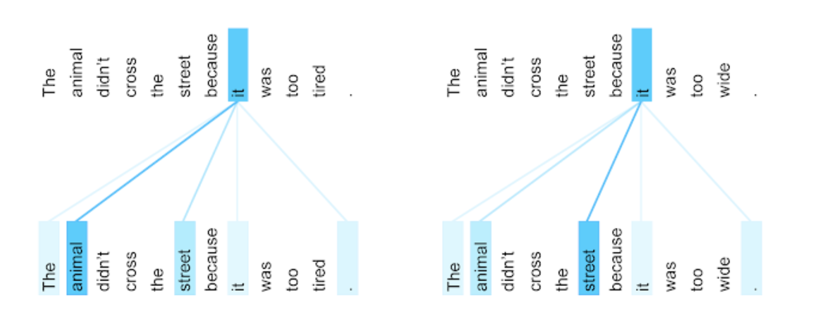
Deep Learning into Generative AI
Another powerful model was developed by researchers at Google in 2017:
Attention is All You Need (Vaswani,et al) – introduced Transformer models
Attention allows NNs to
Evaluate a whole page of text at once, not just one word at a time
Considers how each word relates to all other words in the sentence and page
Learns patterns of language (e.g. adjectives come before nouns)
Notes:
These transformers did so well, and seemed to show “intelligence”
The researchers who invented them didn’t even understand
The more training data, the more intelligence they showed.
openAI was the first to release one to the public, trained on hundreds of billions of “tokens”

Slide 13
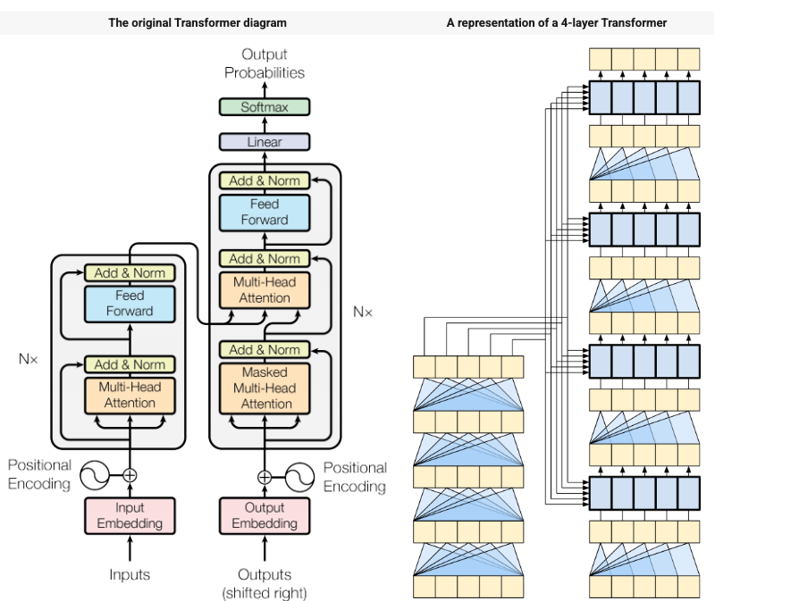
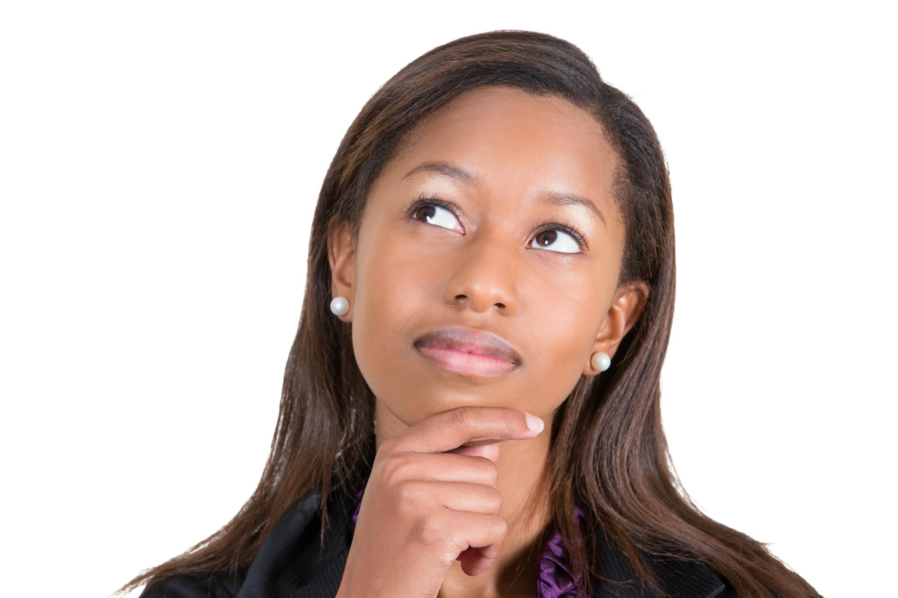
Transformers
Transformers are complicated NN architectures using Attention
Including millions or billions of parameters
GPT was built from Transformers
So…
What is GPT anyway?????
Notes:
What is the training data, the features, the model, the output?
These transformers did so well, and seemed to show “intelligence”
The researchers who invented them didn’t even understand
The more training data, the more intelligence they showed.
openAI was the first to release one to the public, trained on hundreds of billions of “tokens”

Slide 14
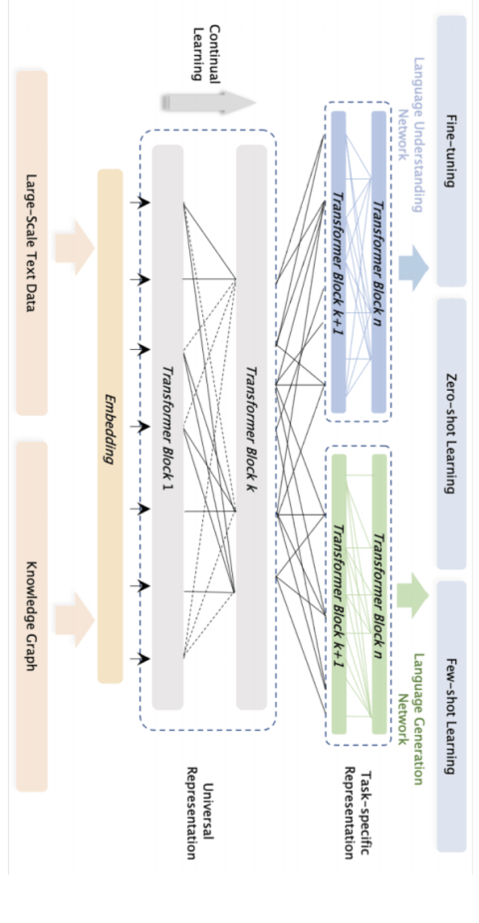
GPT (simplified)
Model Input
(features)
Model Output
(target)
Model
Context Window:
Fixed number of tokens:
Append user prompt (plus context and conversation) to system prompt :
“You are ChatGPT. You are a highly capable, thoughtful, and precise assistant…”
Embedding
Transformer+
Token | P(token)
jumped | 0.030
Is | 0.020
. | 0.010
went | 0.001
wants | 0.002
plays | 0.001
let | 0.001
, | 0.001
User Prompt:
”I need a gluten free recipe for carrot cake. Make it delicious!”
-1.302
0.146
0.386
-1.051
-1.163
-1.961
0.66
0.162
0.815
-0.115
0.003
-0.287
Across entire vocabulary
Training set? : Everything!!!
Notes:
Parameters: model
Input Tokens: how many words, etc can be used as input – Context Window GPT3 = 2k , latest models 128k
Training tokens : how many tokens were used in training
Simplified..not tokens, actually embeddings of the tokens.

Slide 15
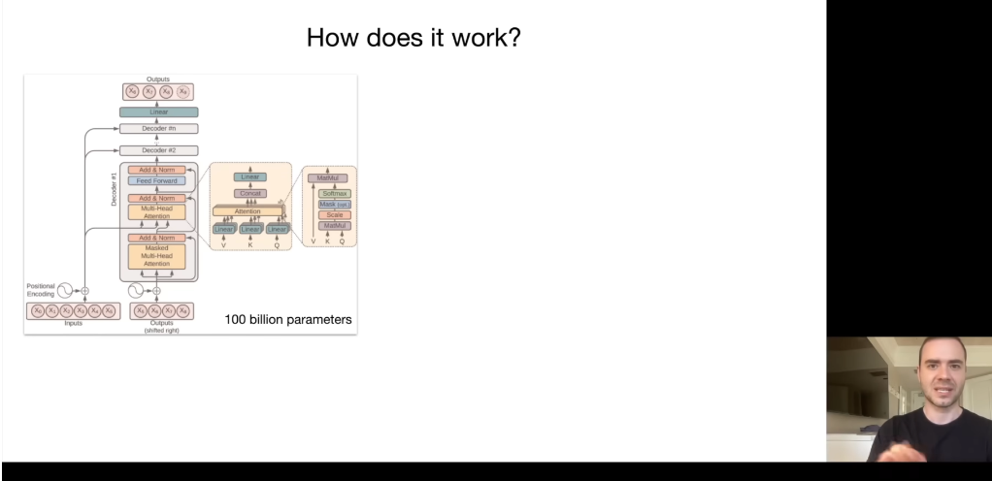
Transformers => Gen AI
As models got larger, so did functionality
Q&A => jokes => dialogue => coding => translation => reasoning
Andrej Karpathy: “Intro to Large Language Models”
We don’t know how these work
https://yout u.be/zjkBMFhNj_g?t=699
Andrej Karpathy
Cofounder of OpenAI
Notes:
13:00-14:00 range

Slide 16
Gen AI Applications

Slide 17

GenAI use case: Starlight Bank
Background:
Starlight Bank wants to deploy an AI assistant to help customers understand:
credit card benefits
loan eligibility rules
dispute resolution steps
fees and interest policies
branch-specific requirements
Their policies change monthly, vary by state, and include hundreds of pages of fine print.
Customer reps currently struggle to stay updated.
Goal:
Starlight wants the AI assistant to:
Give accurate, up-to-date answers
Use Starlight’s official brand voice (formal, concise, risk-averse)
Classify customer inquiry types (fraud, balance transfer, new card, etc.)
Draft customer emails that match compliance standards
Scale to millions of queries per month
Two approaches: Pre-trained vs. Fine-tuned

Slide 18
GenAI: Pre-trained vs. fine-tuned
Pre-trained
Start with general purpose AI
GPT, Claude, etc
Feed it relevant documents (Policies, manuals, etc)
Known as RAG: Retrieval Augmented Generation
Produces chunks of the inputs, and synthesizes into a cohesive output
Doesn’t change the model — you change the context you provide to it.
Use Cases:
Customer service using updated policy documents
Search over large internal HR repositories
Fine Tuned:
Start with general model but train it further on own data
Give it specific examples as guidelines
Changes models internal weights
The model “absorbs” those patterns into its parameters
Use cases:
Domain-specific classification (claims, fraud)
Structured outputs that must follow strict formats
Proprietary information not found in public data
Fine Tuning can be expensive!
Many tasks can be done with Pre-trained + RAG
Notes:
Pros of Pre-trained:
Pros:
No training cost
Uses the latest documents instantly
Easy governance & version control
Usually enough for 80–95% of business applications

Slide 19
Back to Starlight Bank…
Pre-trained + RAG
Allows them to create a general purpose customer information query engine
Great for info, loan eligibility, policies, state-specific guidelines
Can be updated easily behind the scences
Fine-tuned
Can classify dispute cases where consistency with previous precedent is important
Requires training from human-labelled cases (thousands)
Will be better at matching company tone, and use required language
Do pre-trained where you can and fine-tuned where needed

Slide 20
Example: MetroCare Health
MetroCare Health is a large regional healthcare network with:
12 hospitals
80 outpatient clinics
thousands of patient calls per day
complex Medicare/Medicaid billing rules
constantly changing treatment guidelines
They want to build an AI assistant for two tasks:
Classifying incoming patient messages from email, chat, phone systems
Need to classify cases for proper routing
Need to identify urgent cases quickly, and treat them with high precision
Clinical Summaries for doctors and nurses
Must match consistent tone and formatting
Structured summaries for charts need to be in consistent format
Async question: which approach would you argue for?
Pre-trained, fine tuned, or a hybrid?

Slide 21
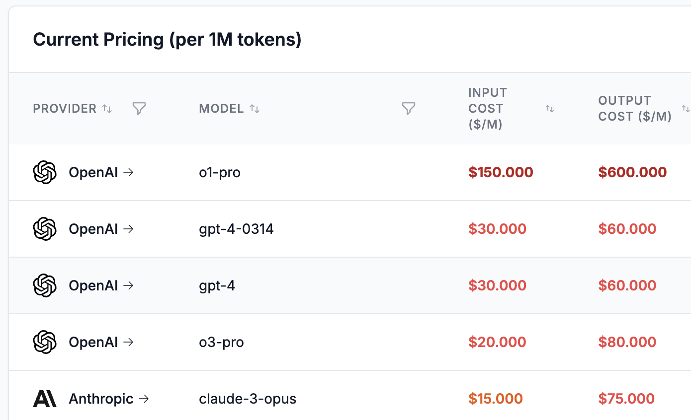
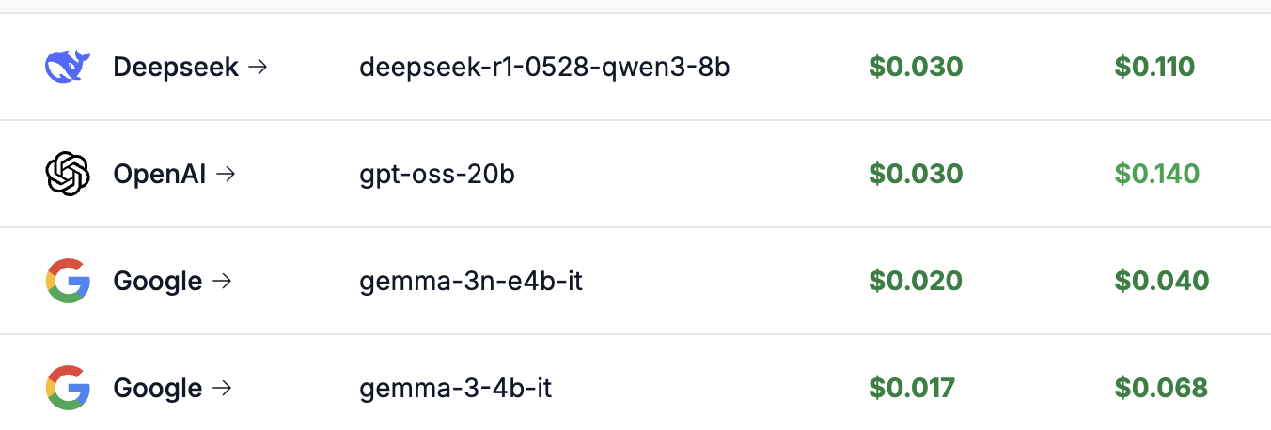

Business Applications
pricepertoken.com
Lots to consider!
use a more expensive pre-trained model?
or
a less expensive model fine-tuned model?
vs

Slide 22


